Slide 1


BLOCKCHAIN TECHNOLOGY
ABDELMALEK ESSAADI UNIVERSITY
FACULTY OF SCIENCES AND TECHNIQUES OF AL HOCEIMA
MASTER : CRYPTOLOGY AND CYBERSECURITY
Presented by : DAOUAYRY Youssef
Supervised by : Pr.EL ALLATI Abderrahim
2023-2024

Slide 2
CONTENT
USE CASES AND APPLICATIONS
FUTURE TRENDS AND CHALLENGES
INTRODUCTION
BLOCKCHAIN : WHAT IS IT AND HOW DOES IT WORK
SIMULATION
CONCLUSION
1

Slide 3
01
INTRODUCTION
2

Slide 4
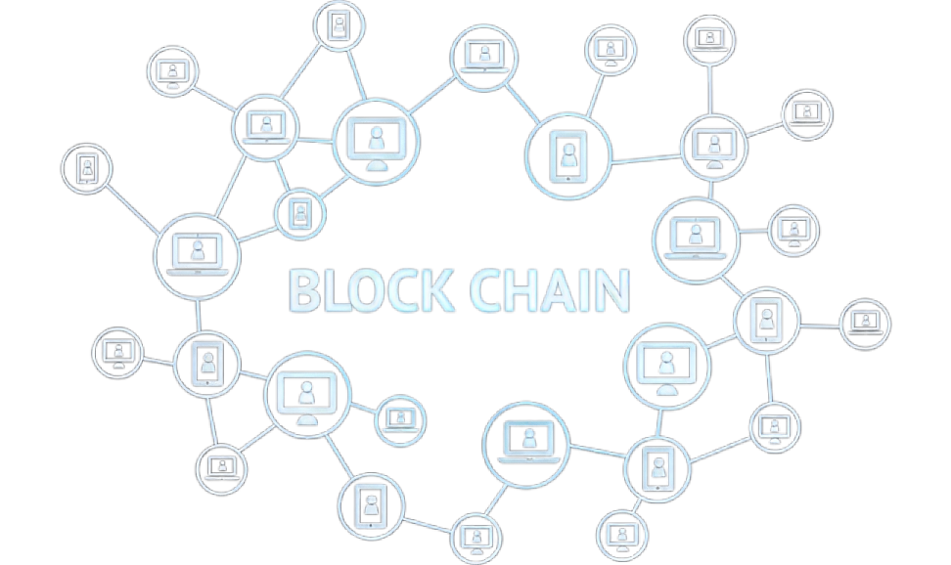
3

Slide 5
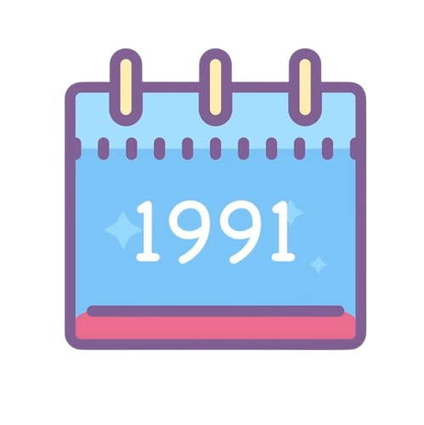
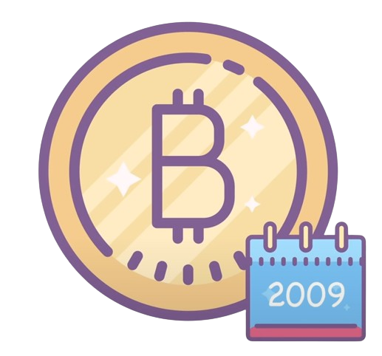
Blockchain was originally described in 1991 by a group of researchers and was originally intended to timestamp digital documents so that it’s not possible to backdate them or to tamper with them.
In 2009, it was used to create the digital cryptocurrency Bitcoin which was the pioneering implementation that demonstrated the practical utilization of blockchain
4

Slide 6
02
WHAT IS A BLOCKCHAIN
5

Slide 7
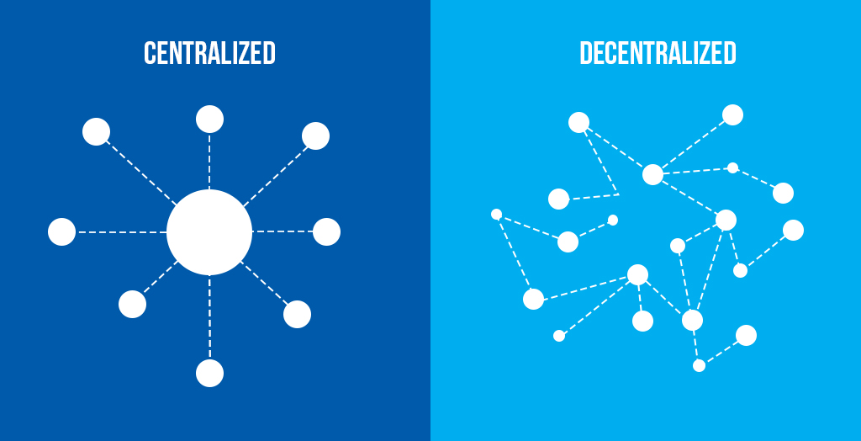
Blockchain
Blockchain can be defined as a distributed public ledger or database of records of every transaction that has been carried out and shared among those participating in the network, the participants are called nodes, and each node has a copy of the blockchain ensuring that any attempt to alter its records would require simultaneous changes across the majority of nodes, which is highly difficult.
6

Slide 8

THE STRUCTURE OF BLOCKCHAIN
Header :
Hash
Previouse Hash
Timestamp
Nonce
Mercle root
Body :
Transaction 1
Transaction 2
Transaction 3
7

Slide 9
MERKLE TREE
Hahs 7 :
Merkle root
Hash 5
Hash 6
Hash 1
Hash 2
Hash 3
Hash 4
Transaction 1
Transaction 2
Transaction 3
Transaction 4
8

Slide 10
MINING
Previouse Hash
Timestamp
Nonce
Mercle root
HASHING (SHA256)
THE BLOCK’S HASH
The hash must follow some criteria
Example : 0000FE25kl2….
Changes every 2016 blocks
9

Slide 11
Consensus mechanisms
Consensus mechanisms are the protocols or algorithms used to achieve agreement among multiple nodes on the validity of block and the order in which they are added to the blockchain. These mechanisms play a crucial role in ensuring the integrity and security, and among the notable consensus mechanisms there is :
Proof of Work (PoW): This was popularized by Bitcoin. Miners race to find the hash to validate and add blocks to the blockchain. It's secure but energy-intensive.
Proof of Stake (PoS): Validators are chosen to create blocks based on the number of coins they hold, validators are chosen randomly, and the probability of selection is proportional to the amount of coins they hold, It's more energy-efficient than PoW.
Delegated Proof of Stake (DPoS): Similar to PoS, but token holders can vote for delegates who validate transactions and produce blocks on their behalf. It's faster but has some centralization risks due to voting power concentration.
10

Slide 12
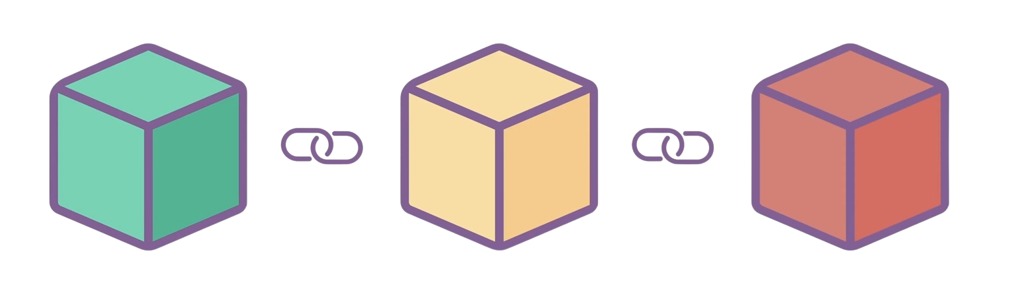
Genesis Block
1
2
3
Hash : 006Bkl23
Previous Hash : 001Z8fwe
Hash : 009t65Fk
Previous Hash : 006Bkl23
Hash : 001Z8fwe
Previous Hash : 000000
00Ha25Ok
Invalid !!!
11

Slide 13
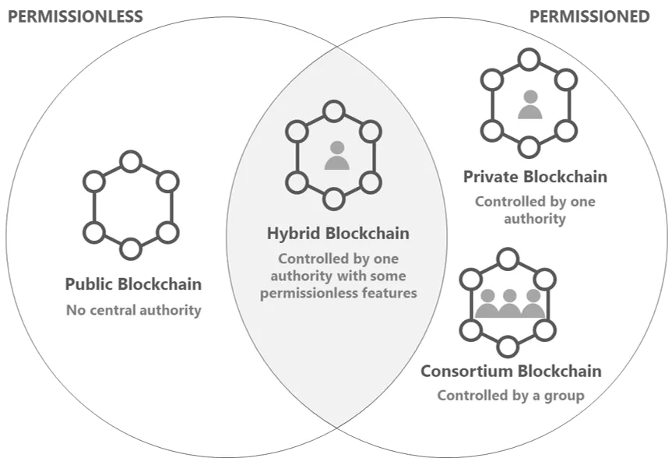
Types of Blockchains
PERMISSIONLESS
PERMISSIONED
12

Slide 14
04
USE CASES AND APPLICATIONS
13

Slide 15
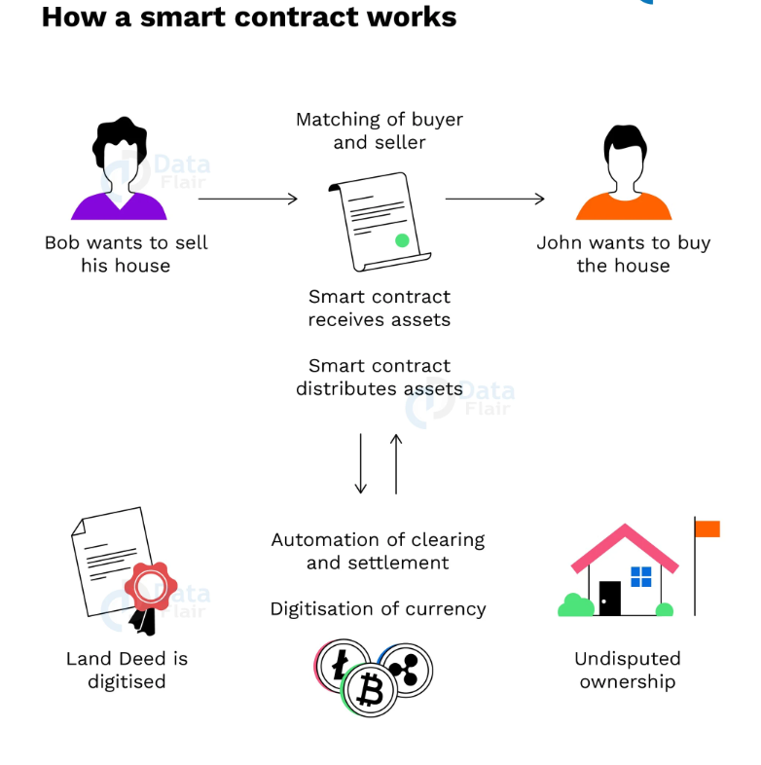
Smart Contracts
Smart contracts are self-executing contracts with the terms of the agreement directly written into code. They run on a blockchain and automatically enforce, execute, or document contractual agreements when predefined conditions are met (such as a certain date, price, or event), eliminating the need for intermediaries .
14

Slide 16
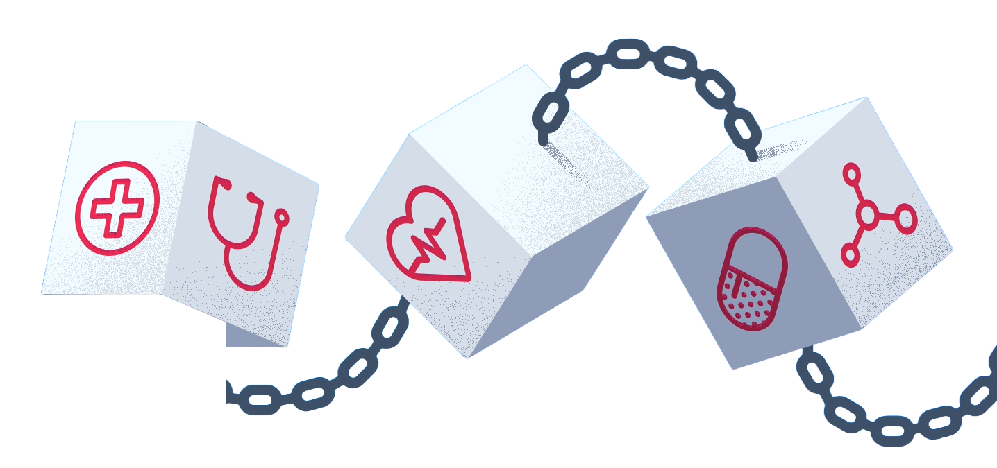
Healthcare
Blockchain technology in healthcare presents a promising avenue for securing patient data. Its decentralized structure ensures data integrity and security. Through encrypted and immutable records, blockchain empowers patients with greater control over their health data while enabling efficient sharing between providers.
15

Slide 17
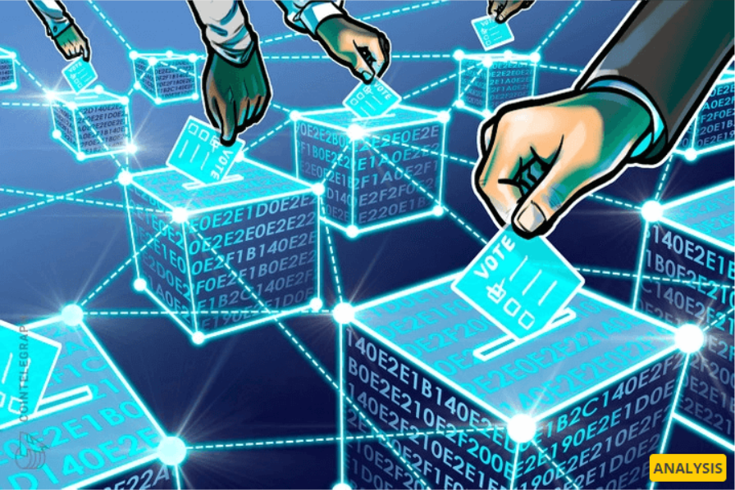
Voting Systems
Using blockchain for voting means using a secure and unchangeable system to record votes. It's like having an open and see-through book where everyone can check that the votes are real and no one can mess with them. This can make voting safer and faire because it stops cheating. It might also let more people vote easily from anywhere
16

Slide 18
05
CHALLENGES AND FUTURE TRENDS
17

Slide 19
The Challenges facing Blockchain
Scalability:
As blockchain networks grow, scalability becomes a significant concern. Transaction speed and throughput are limited in many blockchain implementations, hindering their ability to handle large volumes of transactions.
Energy Consumption:
Some consensus mechanisms, like Proof of Work (PoW), require a lot computational power, leading to high energy consumption.
Costs and
Expenses :
Developing and maintaining blockchain infrastructure can be expensive and costly for businesses, especially for smaller enterprises
18

Slide 20
Future trends
Artificial Intelligence:
AI systems rely heavily on vast amounts of data. Blockchain's immutability and cryptographic features can secure this data, ensuring its integrity and preventing unauthorized tampering. Additionally, blockchain can provide a transparent and auditable record of AI model training, enhancing trust and accountability in AI systems.
Asset tokenization :
Asset tokenization involves representing real-world assets, such as real estate, art, or financial instruments, as digital tokens on a blockchain. These tokens are cryptographic representations that can be bought, sold, or traded.
Central Bank Digital Currencies (CBDCs):
Governments worldwide are exploring or piloting CBDCs using blockchain technology. These initiatives aim to digitize traditional currencies, potentially transforming the global financial system. unlike cryptocurrencies such as Bitcoin, these currencies are backed by the government and are legal tender.
19

Slide 21
06
SIMULATION
20

Slide 22
06
CONCLUSION
21

Slide 23
Conclusion
As we reach the end of our exploration into blockchain technology, we've uncovered its transformative potential across industries. From its decentralized nature to its immutability, blockchain stands as a pillar of innovation.
As we move forward, embracing and understanding blockchain's intricacies will undoubtedly shape the future.
I encourage further exploration of this technology, as it holds a vast amount of information beyond the scope of this presentation.
22

Slide 24
Thank You For Your Attention

